Slide 1
Parts of Computer
Asha for Education

Slide 2
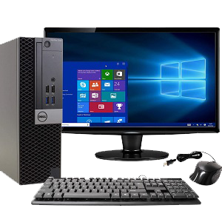
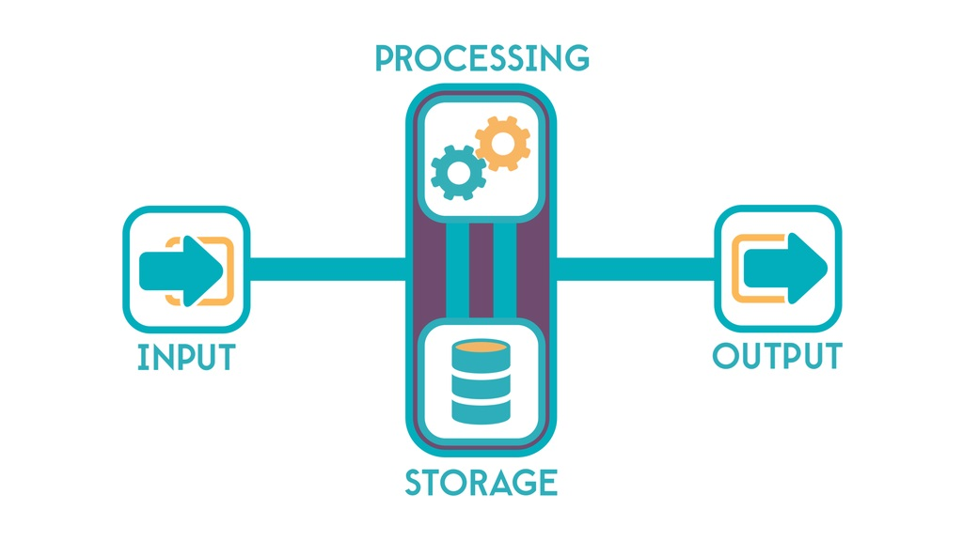
Definition of Computer
A computer is a machine or device that performs processes, calculations and operations based on instructions provided by a software or hardware program. It has the ability to accept data (input), process it, and then produce outputs.

Slide 3
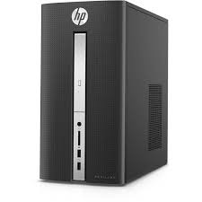
CPU
Central Processing Unit (CPU): The CPU is the brain of the computer, responsible for executing instructions and performing calculations.

Slide 4
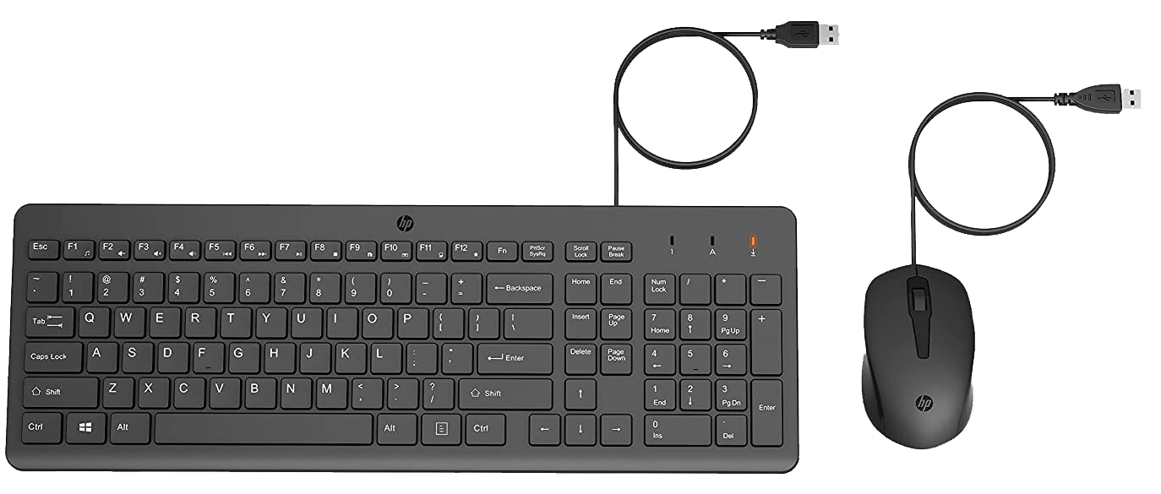
Keyboard and Mouse
Input Devices:
These include devices such as keyboards, mice, scanners, and cameras, which are used to input data into the computer.

Slide 5
Monitor
Output Devices: These include devices such as monitors, printers, and speakers, which are used to display or output data from the computer.

Slide 6
cpu internal parts
Mother Board
CPU
RAM
Disk
SMPS

Slide 7
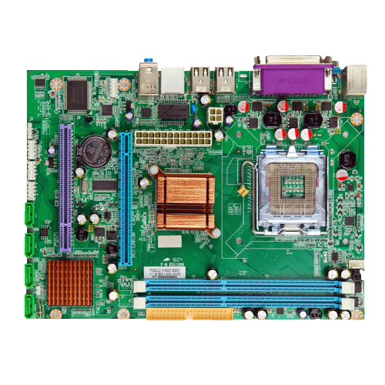
Motherboard
The motherboard is the main circuit board that connects and controls all the other components of the computer.

Slide 8
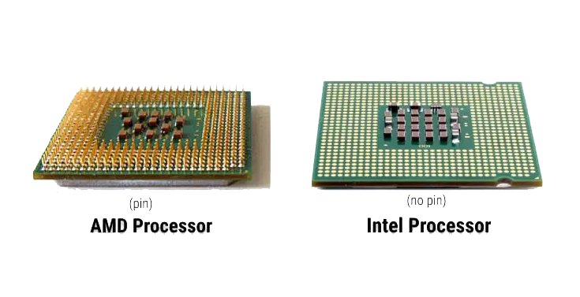
Central Processing Unit (CPU)
The CPU is the brain of the computer, responsible for executing instructions and performing calculations.

Slide 9
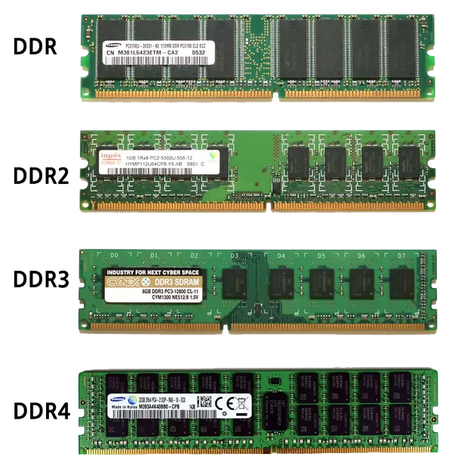
Memory (RAM)
Random Access Memory (RAM) is the short-term memory of the computer that stores data and instructions that the CPU needs to access quickly.

Slide 10
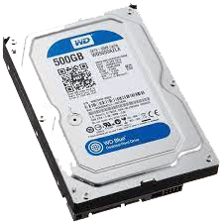
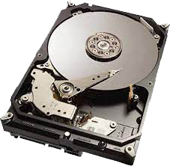
Storage Devices:
This includes hard drives, solid-state drives, USB drives, and other storage devices that are used to store data for long-term use.

Slide 11
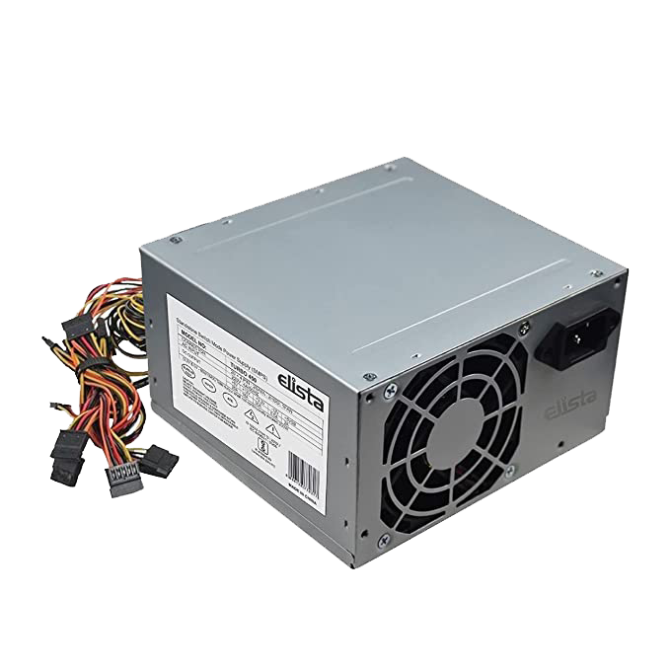
Switch Mode Power Supply (SMPS)
The SMPSU supplies power to the components of the computer.

Slide 12
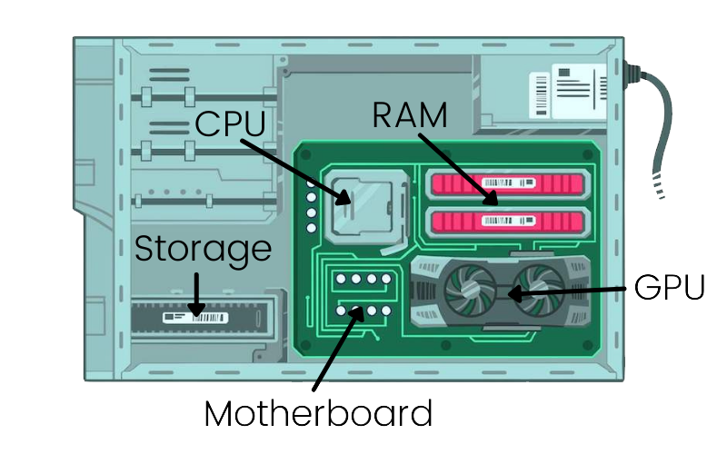
How to Assemble a CPU Parts

Slide 13
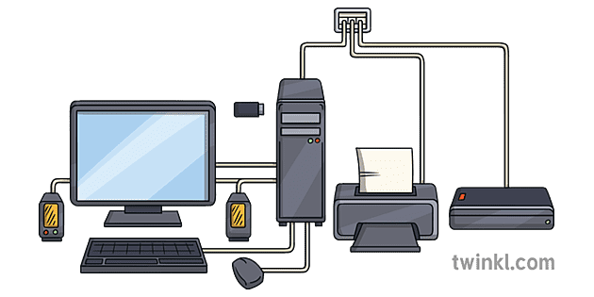
Computer Parts Cable Connection

Slide 14
Thank you
Nethaji M
ashacsnethaji@gmail.com

